Slide 1

KAGGLE CHALLENGE
13/11/2023
Thomas SIMON (65931)
82.05 - Análisis Predictivo - Secondo Parcial

Slide 2

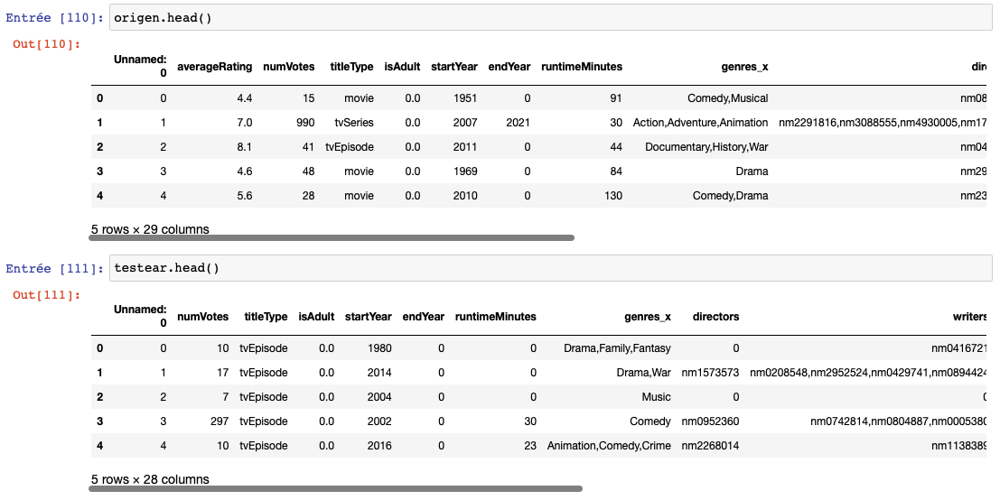

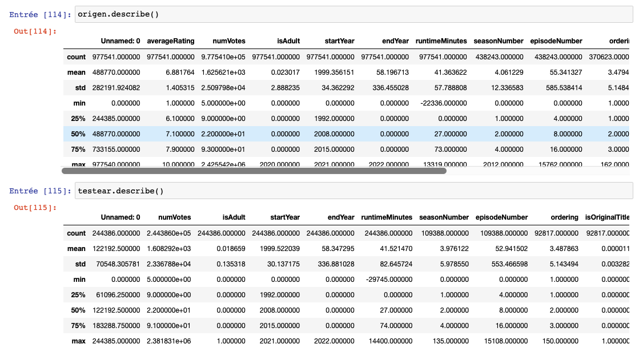
CONTENT
Variables :
- 28 explanatory variables
- 1 variable to be explained : ‘averageRating’

Slide 3
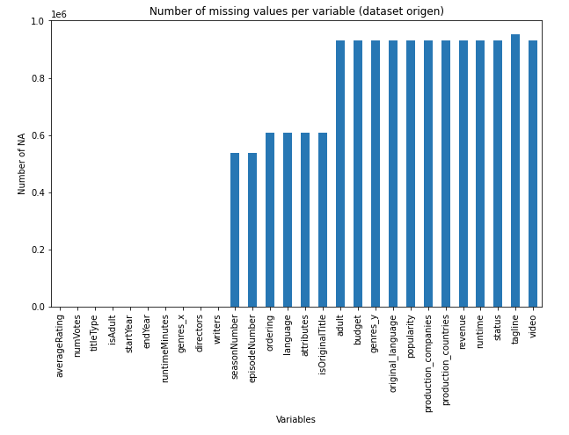
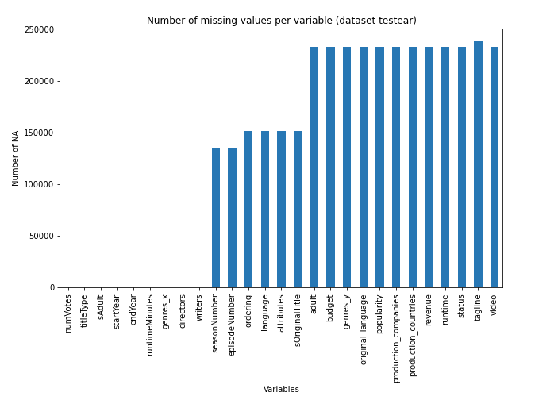
CLEANING

Slide 4
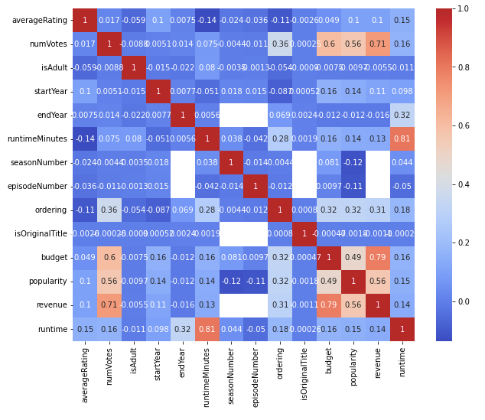
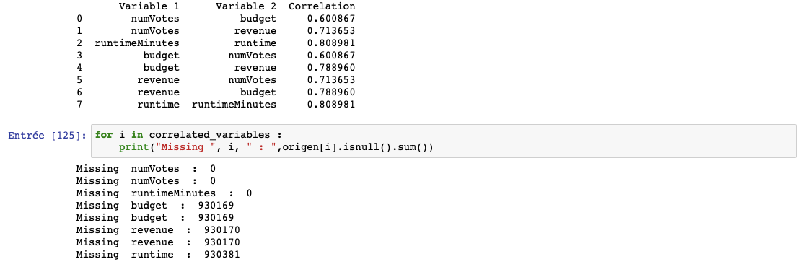
CLEANING

Slide 5
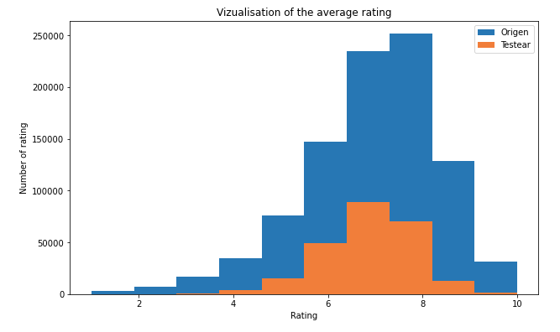
MODELING
Choice of the Random Forest Regressor
Why ?
What advantages ?
What limits ?

